Slide 1
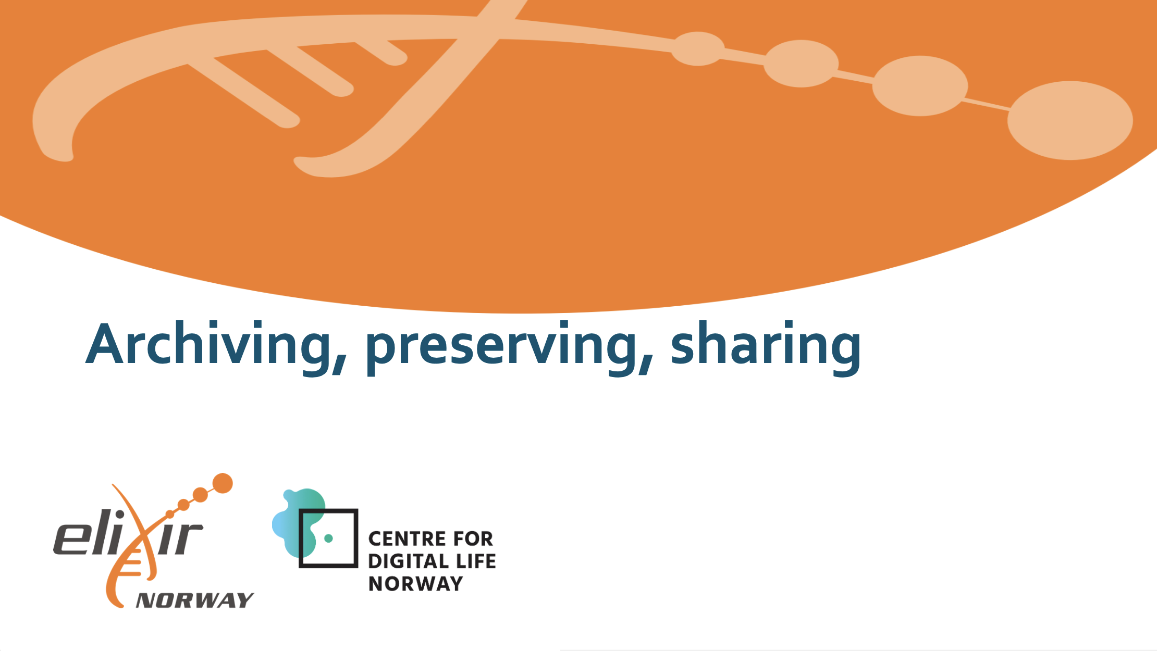
Illimar Rekand,
Illimar.rekand@uib.no
ELIXIR Norway, UiB
This work is adapted from the work of Korbinian Bösl,
and is licensed under https://creativecommons.org/licenses/by/4.0/
Illustrative Icons from Font Awesome licensed under Creative Commons Attribution 4.0 International License

Slide 2
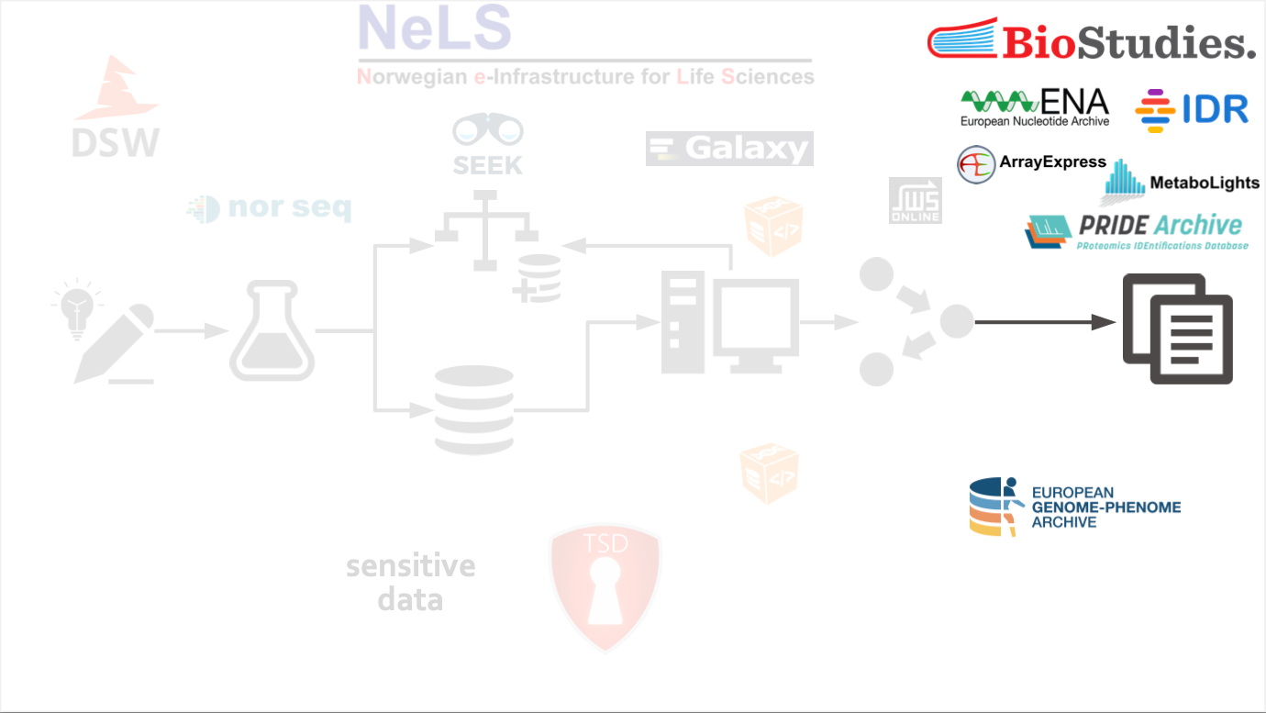

Slide 3
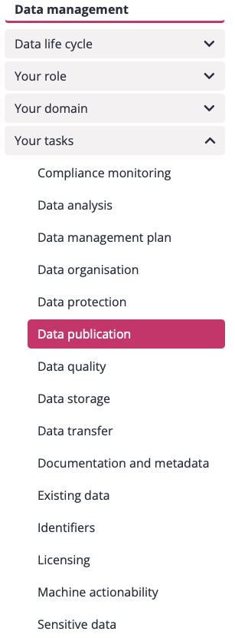
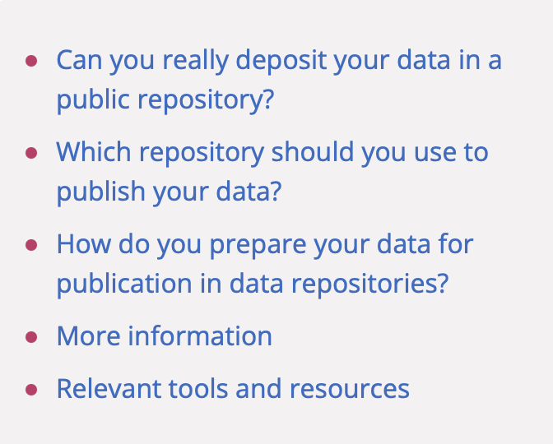
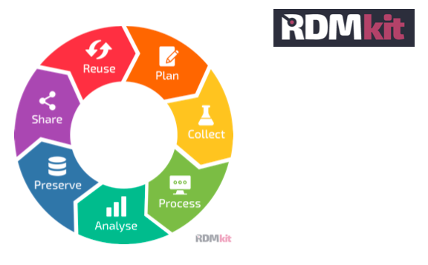
Link to RDMkit: https://rdmkit.elixir-europe.org/
Notes:
resource for Data Management guidelines and good practices for the Life Sciences

Slide 4
Why should I deposit my data?
Increased Visibility (SEO), added value → 25% more citations
Funding agencies requirement; institutions, and journal publishers policies
Save money on storage
http://doi.org/10.1371/journal.pone.0230416
Notes:
SEO: “search engine optimization”

Slide 5
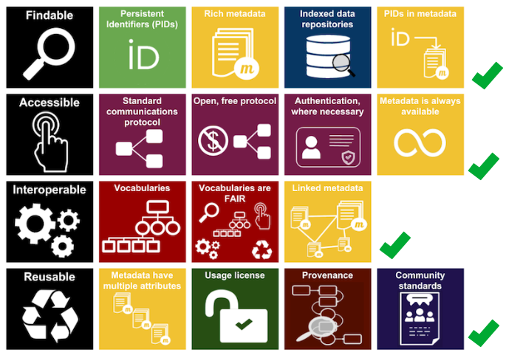
Where should I deposit my data?
Preferably somewhere where
most things are taken care of?
FAIR illustrations icons from ARDC 2018 licensed under Creative Commons Attribution 4.0 International License

Slide 6

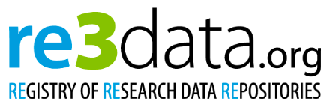
Where should I deposit my data?
1641 databases for molecular biology
Each journal publisher has its own policies and recommendations
fairsharing.org : 1863 registered database
Community-developed platform (including standards, repositories and policies across all disciplines)
re3data.org : 2834 registered database
Registry of Research Data Repositories (overview of existing international repositories of research data from all academic disciplines).
Rigden D.J. & Fernández X.M., The 2021 Nucleic Acids Research database issue and the online molecular biology database collection.
Nucleic Acids Research 49, D1-D9 (2021)

Slide 7
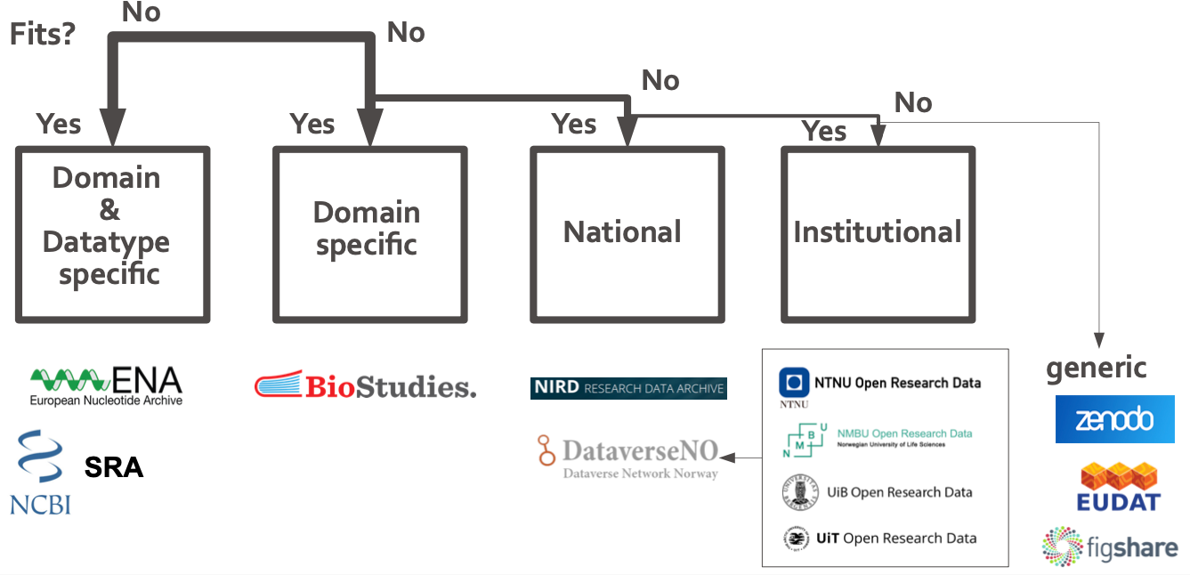
Where should I deposit my data?

Slide 8
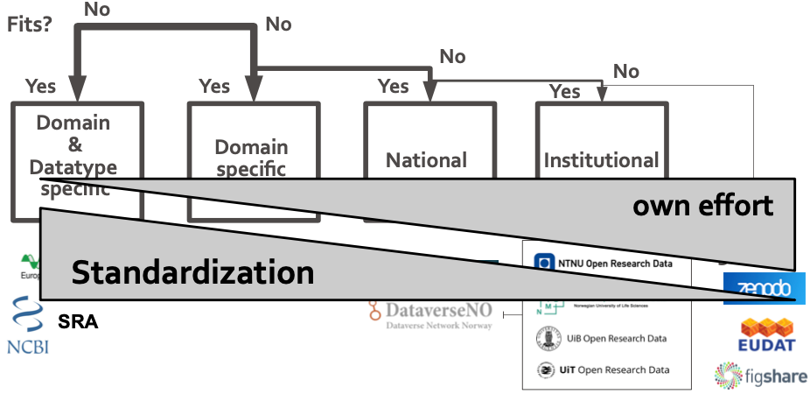
Where should I deposit my data?

Slide 9
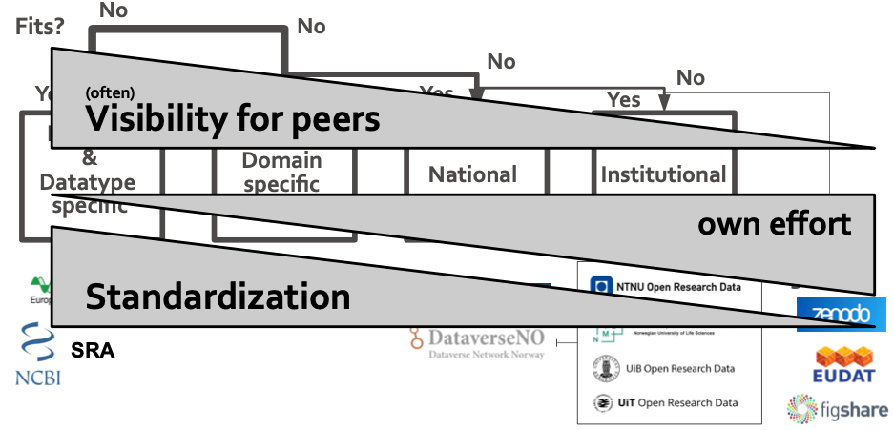
Where should I deposit my data?

Slide 10

Some domain specific archives

Slide 11
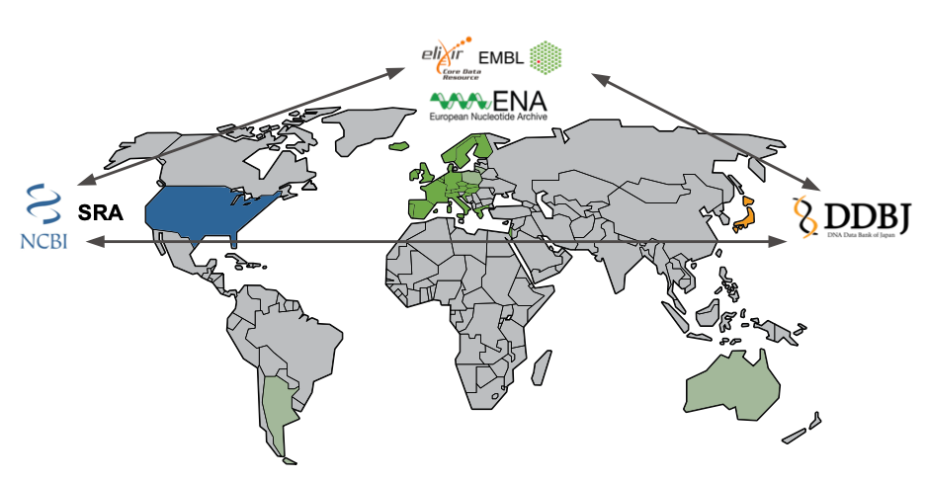
Sequencing data: Multiple Repositories – similar datatypes
Notes:
Those 3 organisation collaborates (international nucleotide sequence database collaboration) to synchronise the data among them.
For each data submitted to either of the 3 repositories, there will be the same data generated in the other 2 repositories.

Slide 12
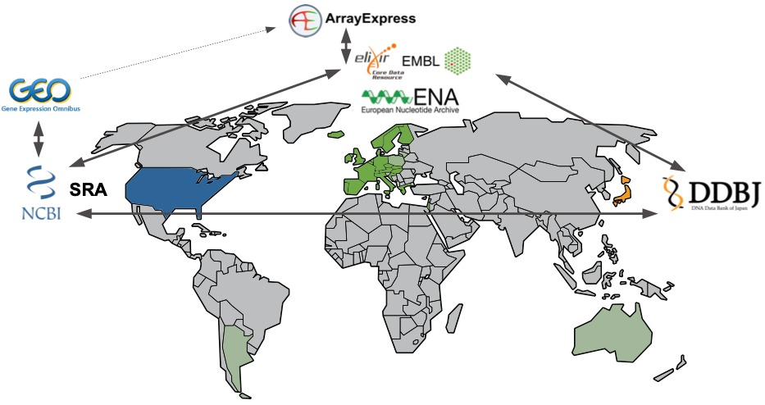
Sequencing data: Multiple Repositories – similar datatypes
Notes:
The SRA is linked to the GEO platform which contains metadata information about the studies. While at ENA, the data is linked with ArrayExpress (which recently becomes BioStudies.)
The data from GEO is used to imported to ArrayExpress;

Slide 13
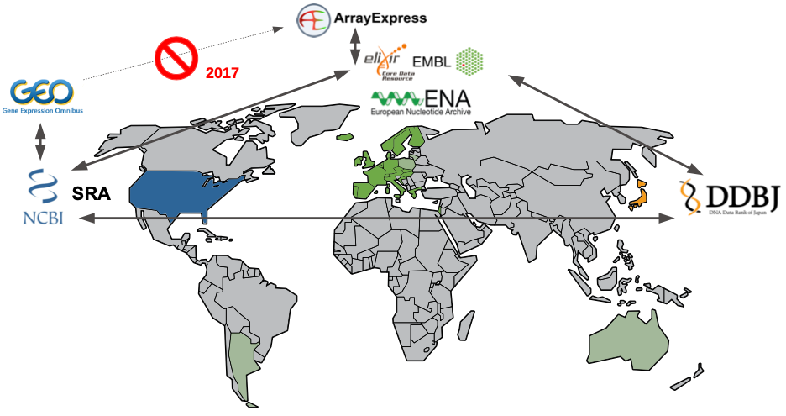
Sequencing data: Multiple Repositories – similar datatypes

Slide 14
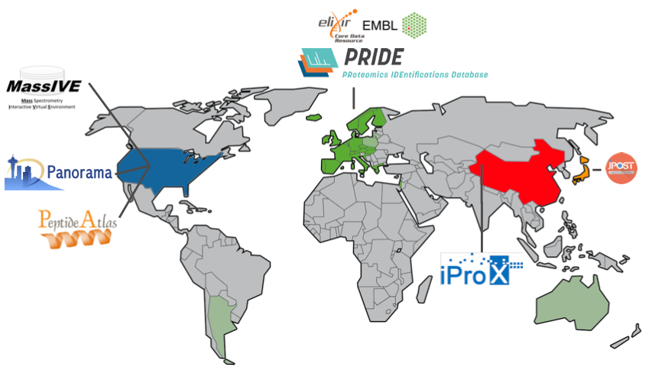
Proteomics data: Multiple Repositories – similar datatypes
Notes:
MassIVE (for mass spectrometry data), Panorama (for targeted mass spectrometry assays that integrates into a Skyline mass, spec workflow), Peptide Atlas from USA;
PRIDE from EMBL-EBI;
iProX from China; JPOST from Japan.

Slide 15
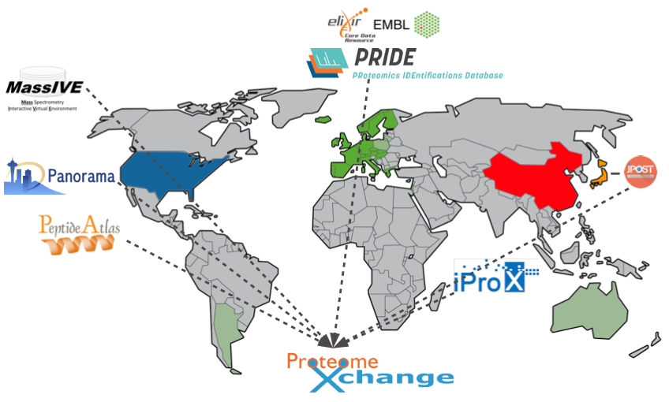
Proteomics data: Multiple Repositories – similar datatypes
Notes:
These repositories do not synchronise the data among them, but there’s a consortium
ProteomeXchange : coordinate standard data submission and dissemination pipelines involving the main proteomics repositories.
In ProteomeXchange you can browse data from all of those member repositories and you will get the meta data as well as link to data deposited in each repository.

Slide 16

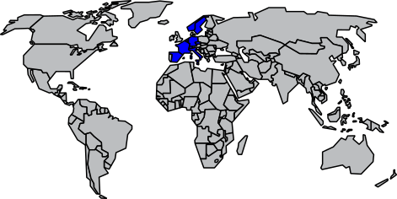
Neuroscience data: Multiple organisations association
A shared digital brain research infrastructure for the EU
Notes:
Next example is another type of repository - which is a single repository but functioned by the collaboration among different associations.
EBRAINS: Repository for neuroscience data. It’s an association consisting of different institutions in multiple European countries such as France,
Spain, Italy, Sweden, Germany, Norway and Switzerland. Its aim to provide a shared digital brain research infrastructure for the EU.

Slide 17
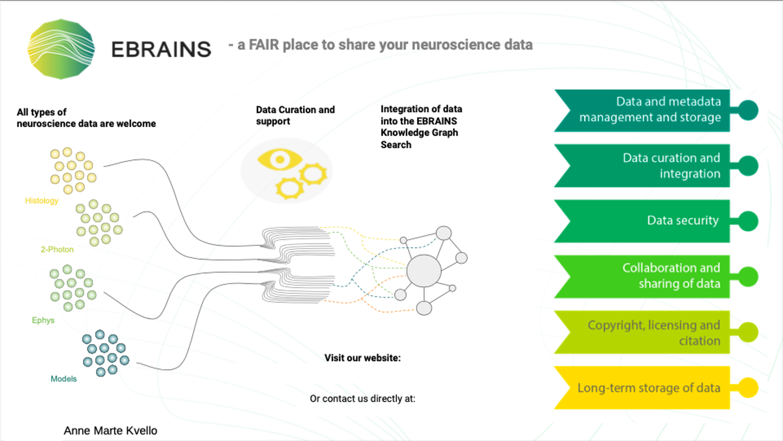
https://ebrains.eu/services/data-knowledge/share-data/
curation-support@ebrains.eu
CC-BY 4.0
Notes:
This welcome all types of neuroscience data. The submitted data would go through a data curation process; that make your data standardise and meet
required criteria before publishing. Then the data can be integrated with The Knowledge Graph Search. Where they integrate the data with tools, i.e. connect a dataset with the software tools that can be used for analysing or visualise that data. And that model makes expand the search capability and make your data more reachable and resuable.
Knowledge graph: Integrates registrered data, models, and software into a graph database, and outlines their relationship to each other (e.g. connecting a dataset to a software tools for analysis and visualization)
Digital tools and services -> challenges in brain research and brain-inspired technology development. Understand human brain function and disease
Different accessibility type (free access, controlled access …), clear, explicit filtering / searching

Slide 18
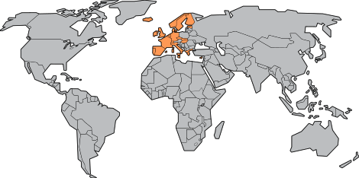
Elixir Data resource services: delivered by different Elixir nodes
Notes:
The data resources of Elixir are delivered by different Elixir nodes.

Slide 19

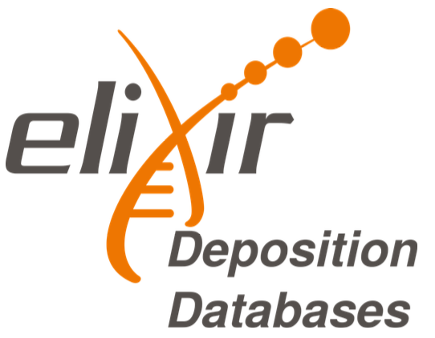
Elixir Data resource services
22 resources of fundamental importance to the wider life-science community and the long-term preservation of biological data
Elixir data resource services
12 deposition database for experimental
biomolecular data
https://elixir-europe.org/platforms/data/core-data-resources
https://elixir-europe.org/platforms/data/elixir-deposition-databases
Notes:
Among those resources, there are 22 that are considered as fundamental importance
to the wider life-science community and the long-term preservation of biological data. They are called the Elixir Core Data Resources.
Beside, there’re 12 of them which are listed as recommended deposition database for bimolecular experimental data.

Slide 20
Elixir Deposition Databases
Recognized & recommended
Free of charge
Quick upload
Not operated by single university/government
Guided submission process
Generous embargo regulation (2yrs)
API access (upload from NeLS planned)
https://elixir-europe.org/platforms/data/core-data-resources
https://elixir-europe.org/platforms/data/elixir-deposition-databases

Slide 21






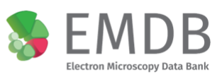





Elixir Deposition Databases
Notes:
Those are the Elixir Deposition Databases: including
Biostudies: collect metadata of a study and link to raw data
ArrayExpress for high-throughput functional genomics experiments, which is merging to BioStudies rencently
BioModels : for mathematical models of biological and biomedical systems.
BioSamples: stores and supplies descriptions and metadata about biological samples
EGA: for sensitive data
EMDB: electron microscopy data
ENA: nucleotide sequencing data
EVA: variant data
IntAct: for molecular interaction data
MetaboLights: Metabolomics experiments
PDBe: 3D structures of large biological molecules such as protein, nucleic acids
PRIDE: mass spectrometry proteomics data
Note that BioStudies can cross link to other repositories (including repo of EMBL-EBI, or outside of the plateform)

Slide 22

Elixir Deposition Databases
Data submission wizard which helps to find the right archive for your data through a series of questions
https://www.ebi.ac.uk/submission/

Slide 23
National repositories
Notes:
Next: as we have seen previously, if your data do not fit any domain specific database, you can consider to deposit to national or institutional repositories.

Slide 24
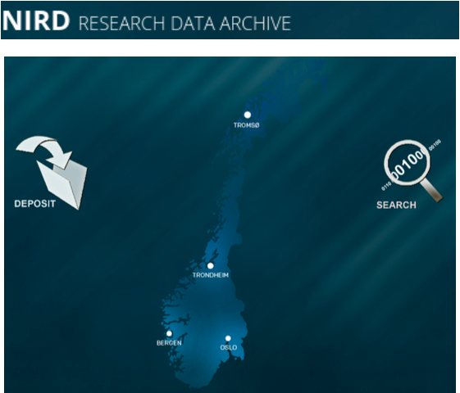
NIRD archive
National, free depositing repository
Domain agnostic
Dublin-core metadata standard
DOI accessible
Supports machine readable metadata harvesting
https://archive.norstore.no
Notes:
Norwegian Infrastructure for Research Data (NIRD)
From sigma2
Domain agnostic: general domain, archiving large data sets. Operated by UNINETT/Sigma2

Slide 25
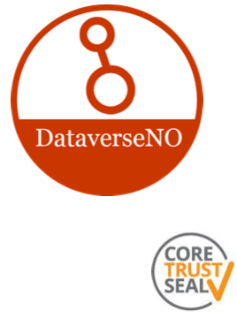
DataverseNO
National/Institutional, free depositing repositories
Domain agnostic
Manually curated by libraries
DOI accessible
8Gb max/upload - contact support >50Gb
https://dataverse.no
Notes:
provide national and institutional repository and are manually curated by libraries, with limited data size.
For this archive, Lars will talk about it more in details in the next

Slide 26



NSD archive
Domain agnostic
DOI accessible
Implemented data access committees
Main data type: Questionnaires, ...
Reorganisation: from 2022 NSD NSD has merged with Uninett and Unit to form Sikt
– Norwegian Agency for Shared Services in Education and Research
https://arkivering.nsd.no
Notes:
Then, we have NSD archive. This is mainly to store questionnaires data. And from 2022, NSD has merged with Uninett and Unit to form Sikt.
NSD has merged with Uninett AS and Unit to form the Norwegian Agency for Shared Services in Education and Research (Sikt). The new organisation will be established from 1 January 2022.
Unit: Directorate for ICT and joint services in higher education and research

Slide 27
Other types of data

Slide 28
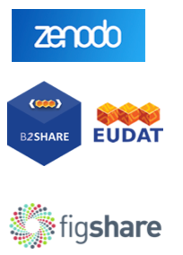
Generic archives
Less standard metadata → Re-usability ⤋
Domain agnostic → Findability ⤋
Guided submission process
Commercial factors: Size limitations, ...
https://zenodo.orgs/
https://b2share.eudat.eu/
https://figshare.com

Slide 29

Archiving code/scripts
Good integration - easy to implement
Archival of each release
beta version for gitlab
https://zenodo.org/
https://guides.github.com/activities/citable-code/
https://gitlab.com/sbeniamine/gitlab2zenodo
Notes:
For code/scripts, a recommended way is to put your code on GitHub and archive them in zenodo for each release. It’s a quite good and easy
process.
There’s developping beta version for gitlab

Slide 30


What about sensitive data?
Central metadata accessibility
Secure storage
Implemented data access committees
Norwegian EGA
(for data that can not leave the country)
ega-archive.org
Notes:
What’s about sensitive data. There’s EGA repository: where the metadata is accessible ; so that everyone can search and know the existence of the data
without having free access to the data. And if someone request to access to a particular data that he is interested in, his request will be going to be accessed
by the data access committee and the owner of the data, and once it was approved you can download the data.
In Norway we have the federated Norwegian EGA for the data that can not leave the country.

Slide 31
What about sensitive data?
Central metadata accessibility
Secure storage
Implemented data access committees
Norwegian EGA
(for data that can not leave the country)
Ensure your consent form & REC approval allow controlled access archiving!
ega-archive.org
Notes:
You should ensure your consent form & REC approval allow controlled access archiving.

Slide 32
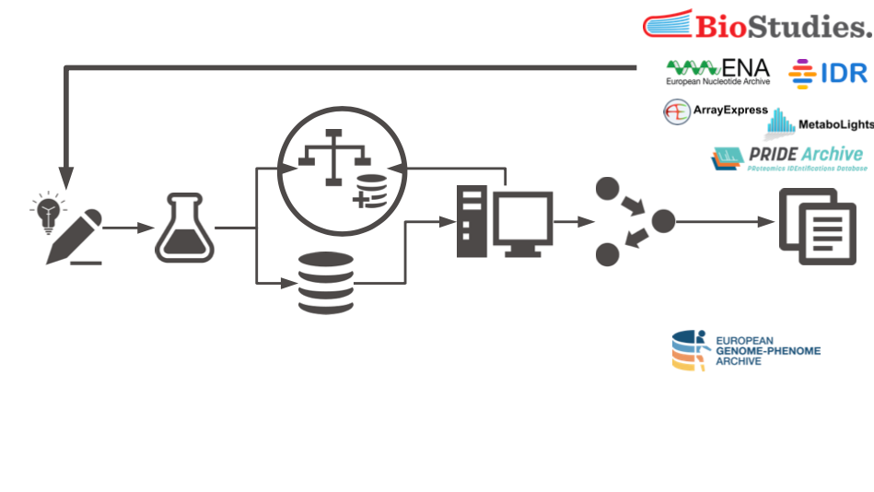
Illimar Rekand,
Illimar.rekand@uib.no
ELIXIR Norway, UiB
Notes:
Archiving data allow the reuse of data, so your data can be served in another project.

